Slide 1

Lending Works/Fluro Loan Data Analysis
By Mohamed Kamara

Slide 2

Project Overview
Introduction
Goal Definitions
Data Gathering and Consolidation
Data Cleaning and Preparation
Feature Selection
Exploratory Data Analysis
Model Selection, Training and Testing
Conclusion
References

Slide 3
Introduction
The purpose of this project is to gain meaningful insights and analytics using statistical and supervised machine learning based approaches.
This can be done using decision trees, K-nearest neighbours, SVM or neural network based classifiers.
We'll be exploring all of these classifiers to see which provides the highest model accuracy after backtesting.
Calculations for the mean, standard deviation (variance) and correlation coefficients can also be made to further understand the numerical features.

Slide 4
Goal Definitions
1. Repayment Status Prediction - Predict the probability of a loan being either repaying, repaid, cancelled, late or defaulted based on the features listed above. (Multiclass Classification)
2. Principal Outstanding Prediction: Predict how much of the loan will have been repaid. (Regression)

Slide 5
Data Gathering and Consolidation
The first step of data gathering involved downloading the .csv file from the Lending Works website [1]. ‘Data is correct up to 31/07/2022 and statistics are updated quarterly as per the FCA requirement.’
In order for the file to be read properly by Pandas in Python, it had to be converted to the UTF-8 text encoding to avoid errors.
A quick glance of the data revealed 33,497 data points.

Slide 6
Data Cleaning and Preparation
The data cleaning and preparation involved reading the .csv files directly into Python using Pandas and selecting the columns corresponding to the features we would like to use.
However, I ran into problems as the dates stored in the .csv file were stored in multiple formats (e.g. dd-mm-yy and date/month/YYYY) so these had to be edited within the file to solve this issue.
Dates then had to be converted to days and categories encoded using one-hot encoding as machine learning models can only take numerical inputs.

Slide 7
Feature Selection
The 8 features being explored in this data set:
1. Loan Age (days)
2. Term (months)
3. Days Remaining
4. Loan Purpose (Personal Loan/Sole Trader)
5. Repayment Status (Repaying, Repaid, Cancelled, Late, Defaulted)
6. Loan Amount
7. Gross Rate
8. Principal Outstanding

Slide 8
Feature Selection
Despite lacking more predictive features such as age, income, gender etc. due to limitations of the dataset, insightful information can still be gained.

Slide 9
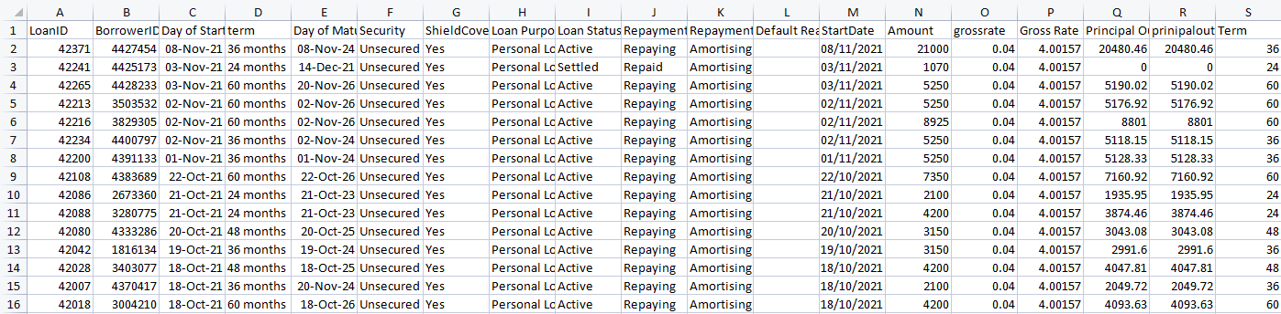
Feature Selection
Columns LoanID and Borrower ID were removed as they appear to have little predictive power and can reduce the accuracy of the model.
Redundant columns with repetitive data is also removed to save memory and reduced unnecessary complexity.

Slide 10
Exploratory Data Analysis
Means and Standard Deviations of Numerical Data:
Loan Age: (1533.3, 557.8) Days
Term: (43.6, 16.2) Months
Days Remaining: (-585.9, 831.0) Days
Loan Amount: (6500.8, 5376.5) Pounds
Gross Rate: (5.17, 0.94) %
Principal Outstanding (1550.6, 3068.9) Pounds

Slide 11
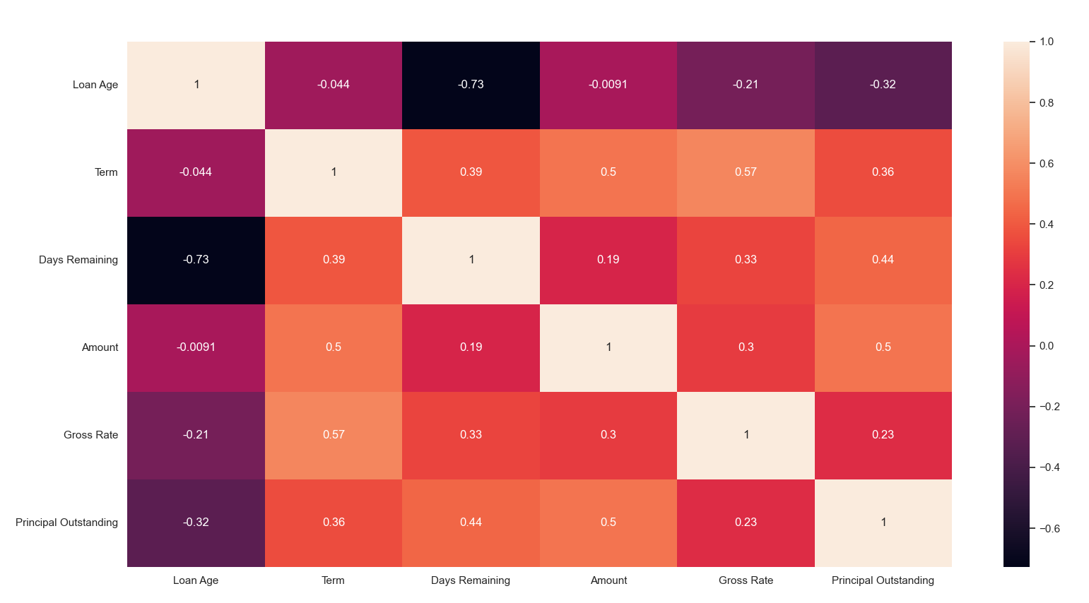
Exploratory Data Analysis
A quick holistic
overview of how the
variables relate to
each other with a
correlation heat map

Slide 12
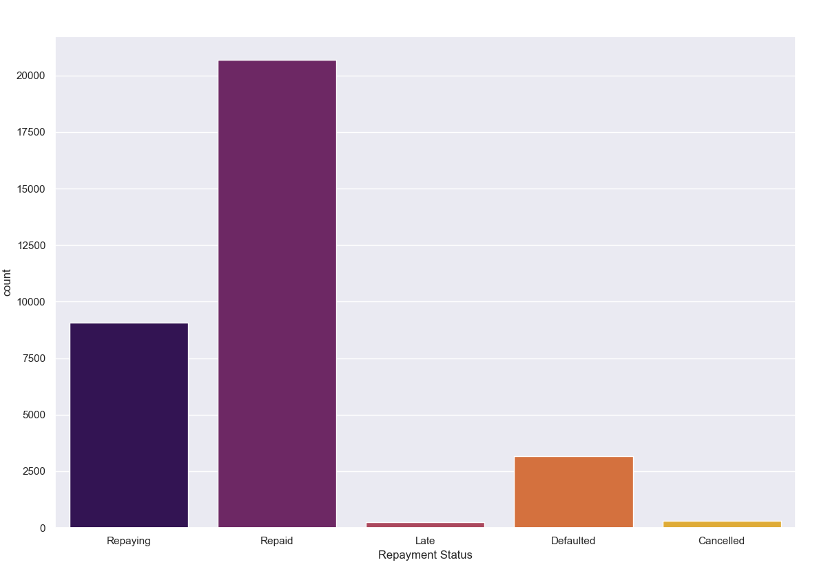
Exploratory Data Analysis
We would expect that
a majority of the loans
would be classed as
repaying or repaid, a
smaller but significant
proportion of defaults
and very few cancelled
and late payments

Slide 13
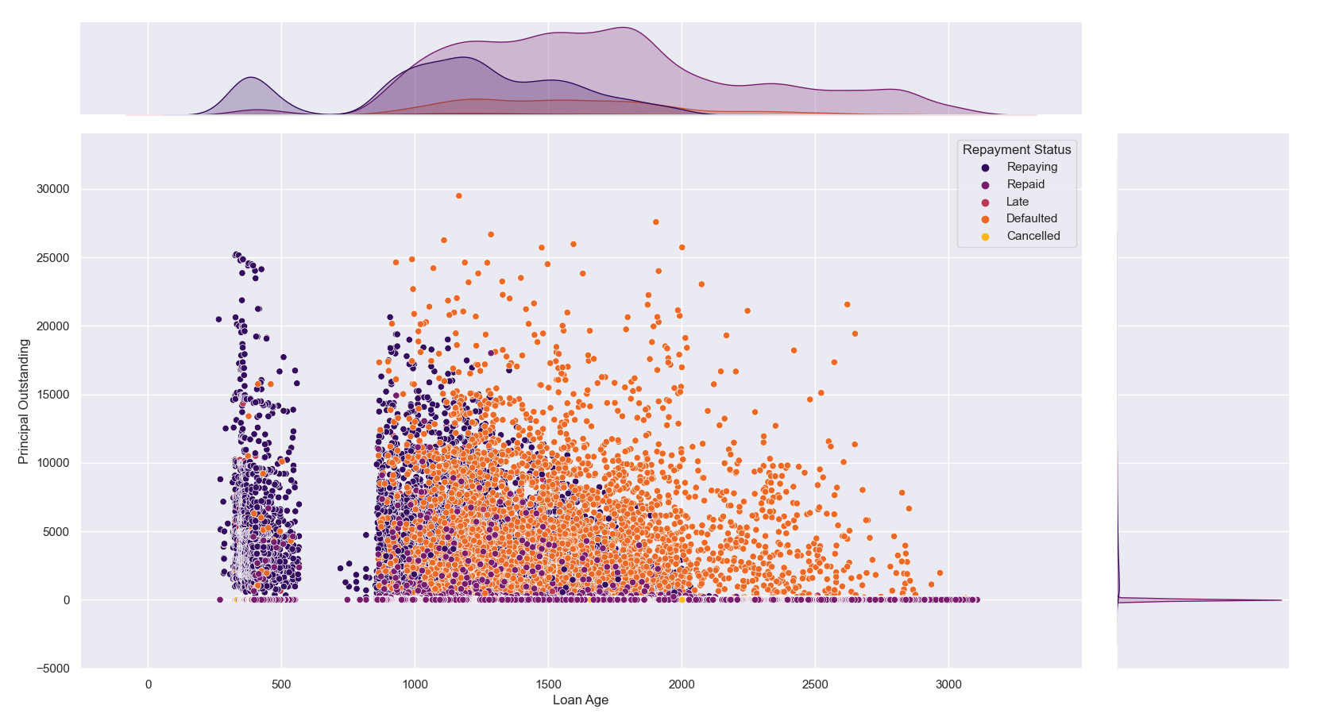
Exploratory Data Analysis
Defaulted loans appear to
vaguely cluster away from
other loan classes.
A large gap can clearly
be seen between 600 and
800 days ago,
corresponding to the lack
of loans during the
pandemic.

Slide 14
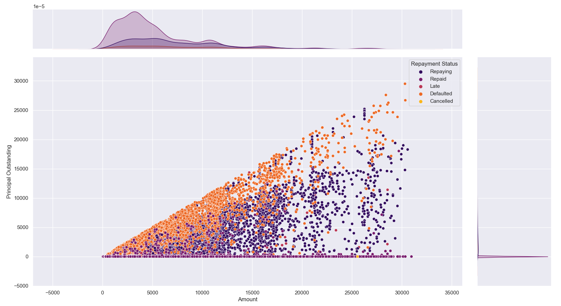
Exploratory Data Analysis
Mean loan
amount and
standard deviation
can be seen in the
histogram above.
Defaulted loans
cluster near y=x.

Slide 15

Model Selection, Training and Testing
Decision Tree, Random Forest and Deep Neural Network classifiers were used, making use of 80% of the the data for training and 20% of the data for testing the model accuracies.
The data is randomly shuffled in order to limit bias between the training and test data.

Slide 16
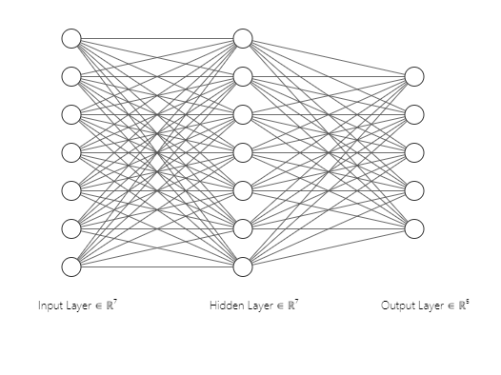
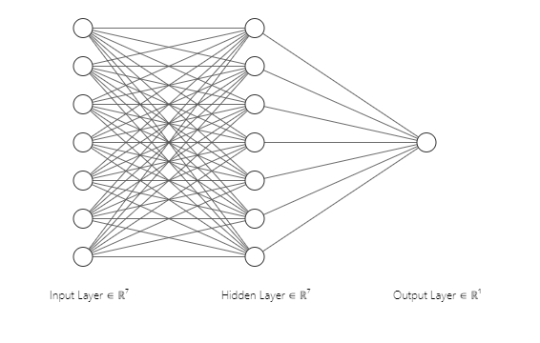
Neural Network Architecture
The classification network consists of 7 inputs, a single hidden layer of 7 neurons with ReLU activations and 5 output neurons for each of the classes with a softmax activations. The regression network consists of a single output neuron with a linear activation function.

Slide 17
Conclusions
Other models can be used in the future to improve performance e.g. Support Vector Machines, ensemble algorithms
Regularisation can be used to limit the effect of overfitting the dataset
Normalisation/scaling can improve training times

Slide 18
References:
[1] https://www.lendingworks.co.uk/about-us/statistics
https://www.doria.fi/bitstream/handle/10024/182846/himberg_tomi.pdf?sequence=2&isAllowed=y
https://www.analyticsvidhya.com/blog/2022/04/predicting-possible-loan-default-using-machine-learning/
https://github.com/Nyandwi/machine_learning_complete
Questions?

